Slide 1
M1 Project

Slide 2
Purpose
Practice and consolidate
Static HTML, CSS and JS
API
Learn by failing
Personal insights
Technical insights

Slide 3
Next steps
Idea
Validation
How to plan session
Define MVP
Create Readme
Trello board
Sign-off
next 2 or 3 days

Slide 4
Idea
Simplify the idea to something you think you can build in 4 days

Slide 5
Validation
Run the idea(s) through the TAs or the LT so they can green light it

Slide 6
Planning Session
“By failing to prepare, you are preparing to fail.”
_{- Benjamin Franklin}

Slide 7
MVP - Minimum Viable Product
States/Wireframes
Data Structures
Task List
Using DOM
ES5 – ES6
API calls
Responsive – Mobile First
Use of animations
Draw the app pages
Draw the user flow
Break down your tasks
Small tasks
Order them by priority

Slide 8
Tools Wireframes
https://balsamiq.com/
https://www.mockflow.com/

Slide 9
App pages
Home
App page
FAQ
Sign Up
Log In

Slide 10
Readme.md
Documentation is key for success
Use the template we provide
Keep track of your planning
Update plan if it changes
Link template
Example Read Me

Slide 11
Project Examples
What’s for dinner: - https://fx2000.github.io/whats-for-dinner/ Summer in Mars- https://alejandrocolorado.github.io/summer-in-mars/index.html
What I read- https://murbano17.github.io/whatiread-m1/index.html
Harry Potter - https://patricio-bot.github.io/Proyecto-MD1-HarryPotter/index.html
Be Hoppy - https://javirep.github.io/BE-HOPPY/index.html
Easy Delivery- https://easydelivery.albertehc.com/index.html
Wheel of force - https://puigmar.github.io/Wheel_of_force/index.html

Slide 12
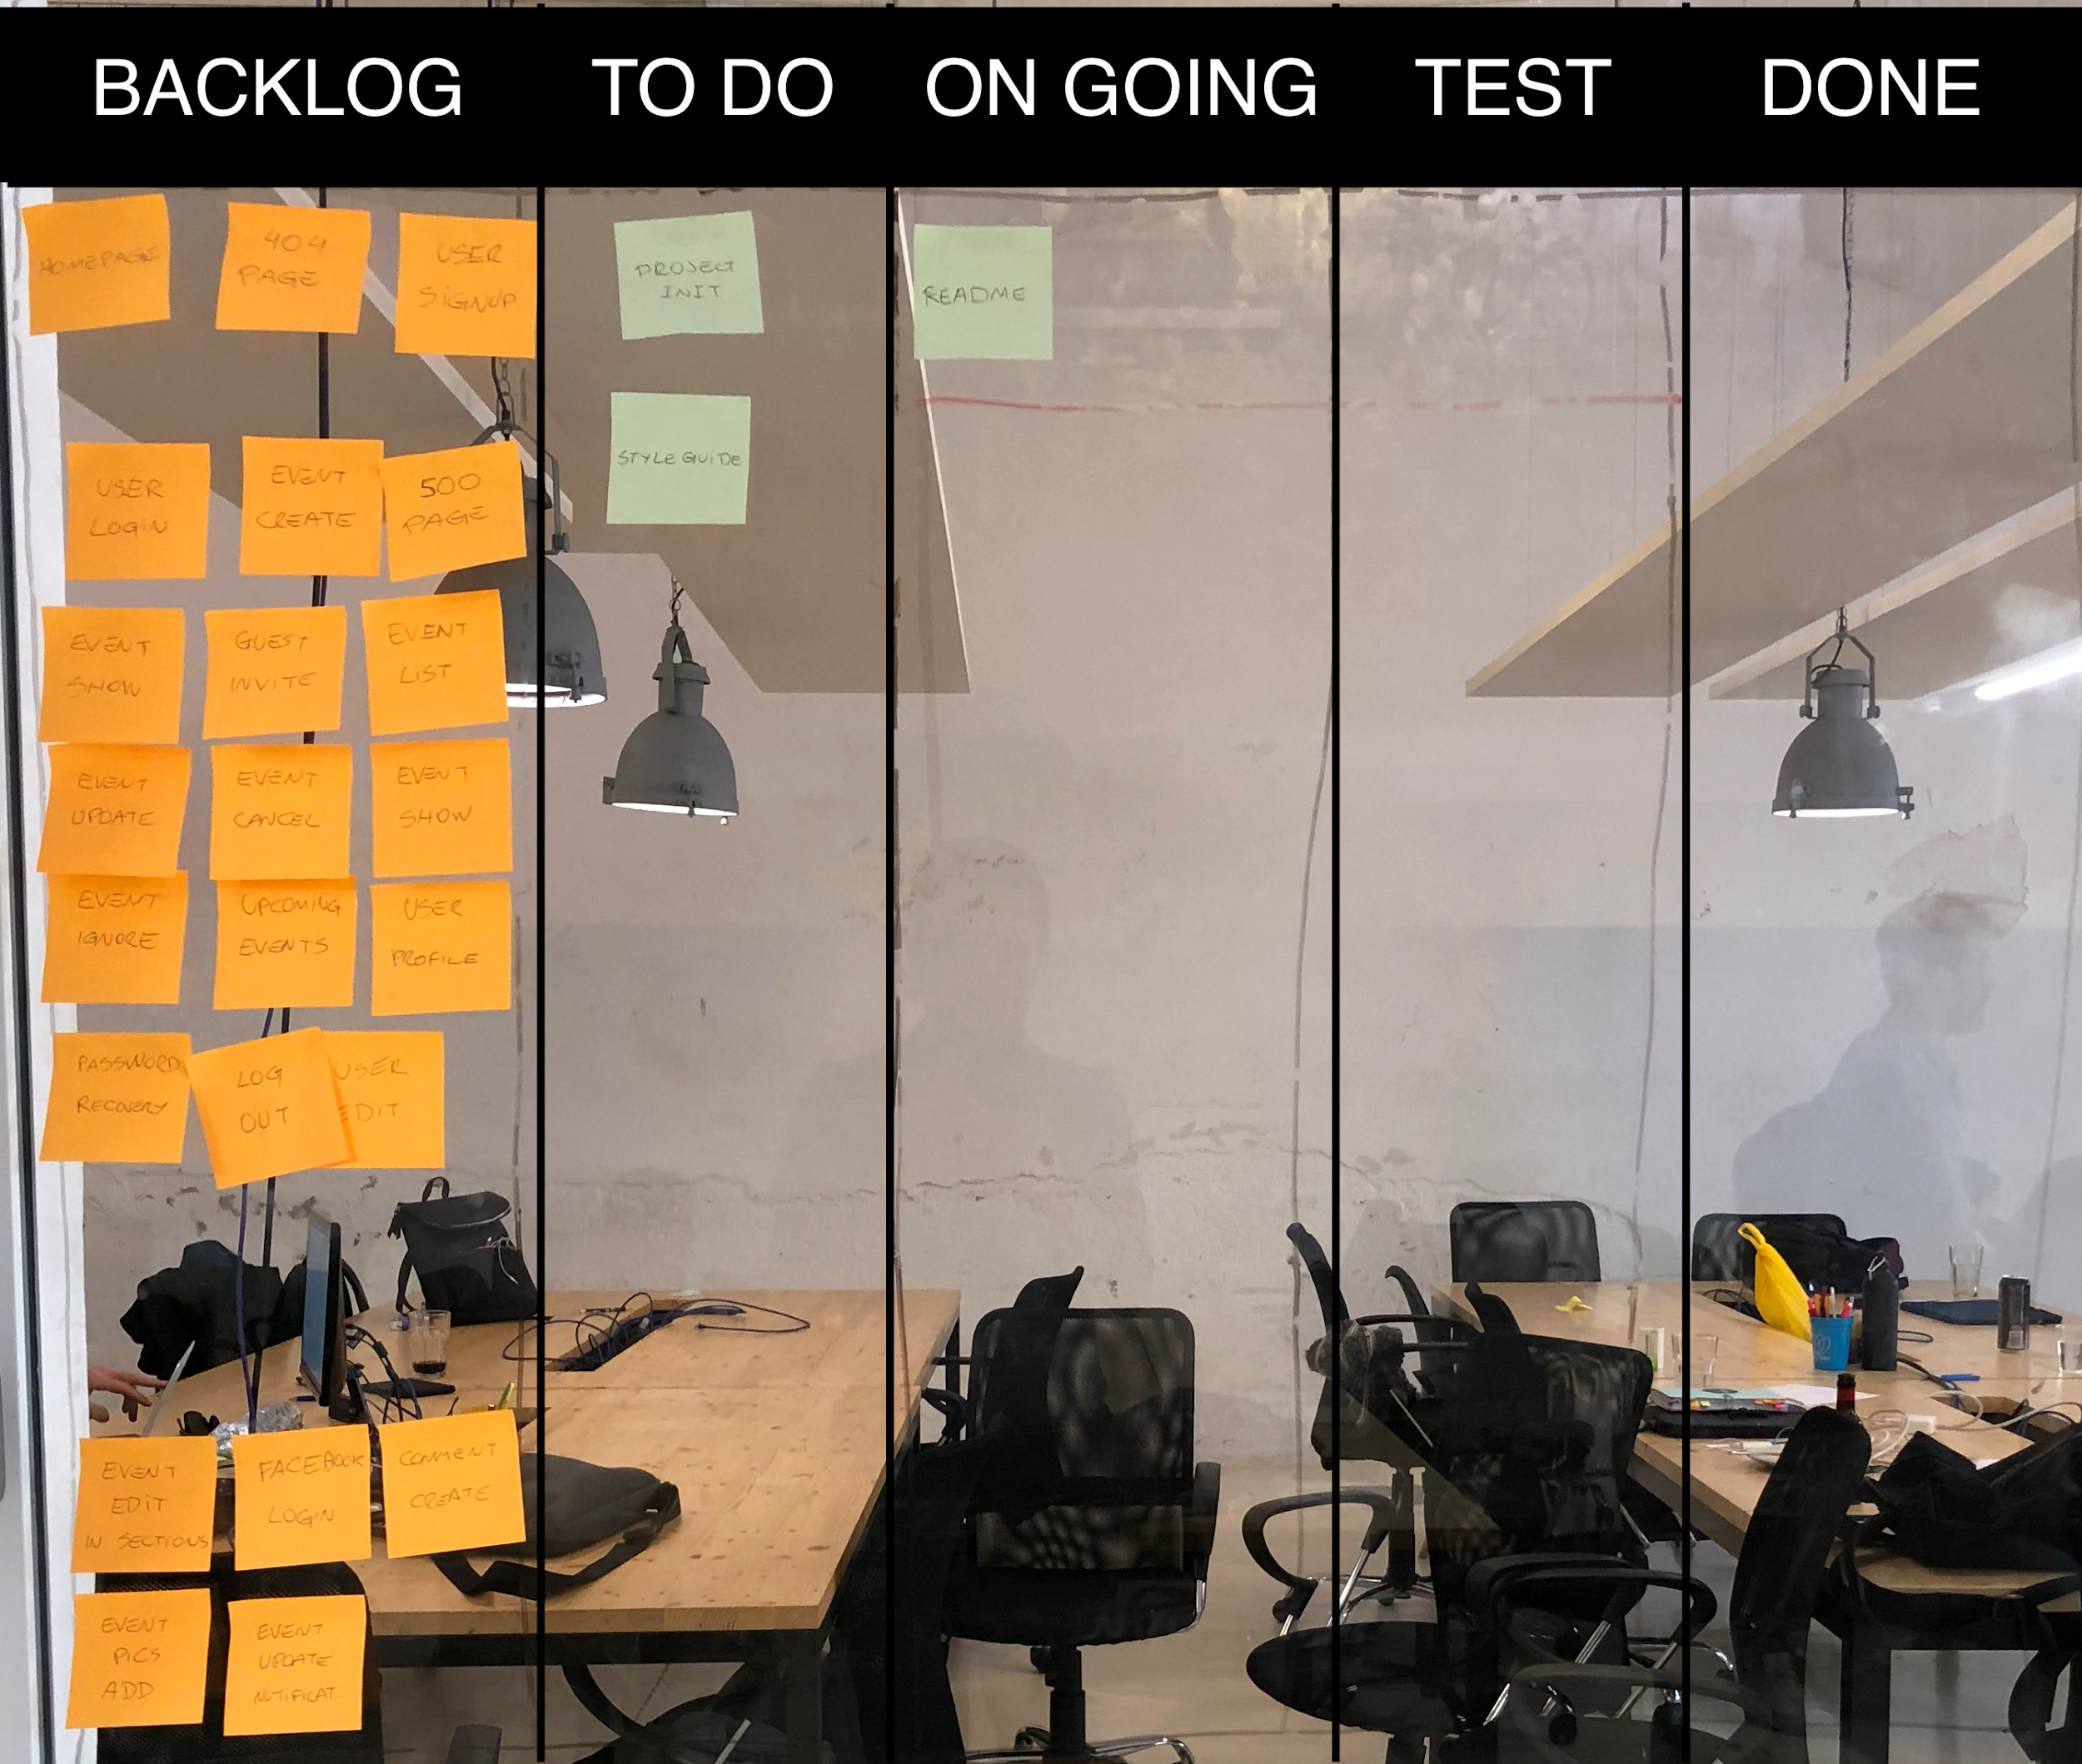
Trello Board

Slide 13
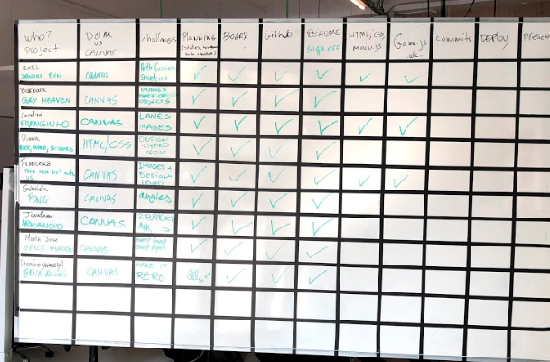
Sign-off time

Slide 14
CAPTAINS
Dani
Leandro
Julián
Marina
Esteve Martín
Eric Blair
Adrián Paniagua
Clàudia Doñate
Raiza Escobar
Carlos Curtido
Jose Luis
Xavier Caparrós
Andreu Martinez
Adreu Sanchez
Mar Curto
Cristina Castro
Samantha
Meritxell
Adrià
Alejandro Ollé
Mathilde
Ona
Sara Amentegui
Eryfili
Oscar Mellado
Christian Hernandez
Jonathan
Marc Sadurni
Marta Camacho
Carla Navia
Alberto Polanco

Slide 15
Typical project day
Kata 09:00 – 10:00 - Friday, Monday, Tuesday, Wednesday)
Stand-up (10:15am)
Code
Slide preparation (4:30pm)
Presentations (5:00pm)
Notes:
Tell them to make sure they eat during the coding. Say that the slide preparation can sometimes be at 4h30

Slide 16
Deployment
Localhost Devs < Web Devs
GitHub Pages
Deploy early
Deploy often
Test online

Slide 17
Presentation Day
Code freeze
Presentation time

Slide 18
Code freeze
No crazy features on Friday
Reserve some time to work on your presentation
Refactor small bits of your code and commit often
Notes:
Joke about the order of the presentation that is a special algorithm invented by NASA (cards)

Slide 19
Presentation time
Order of presentations is randomized
5 mins per presentation
And then…. BEERS BEERS BEERS
Notes:
Joke about the order of the presentation that is a special algorithm invented by NASA (cards)

Slide 20
Resources
API
Colors
https://any-api.com/
https://github.com/public-apis/public-apis
https://colorhunt.co/
Images
https://unsplash.com/
https://www.freepik.es/

